Slide 1
Group 12 Buildout Project
Alexander Blanchette, Jamel Douglas, Andrew Vargas, Matthew Lewis, Maurice Channelle

Slide 2
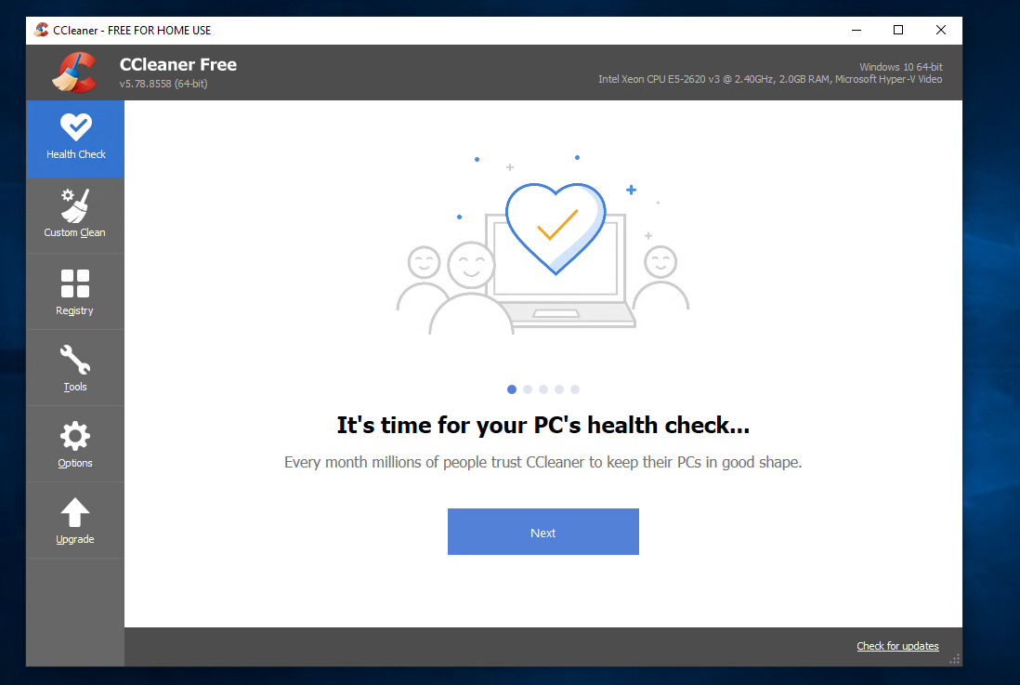
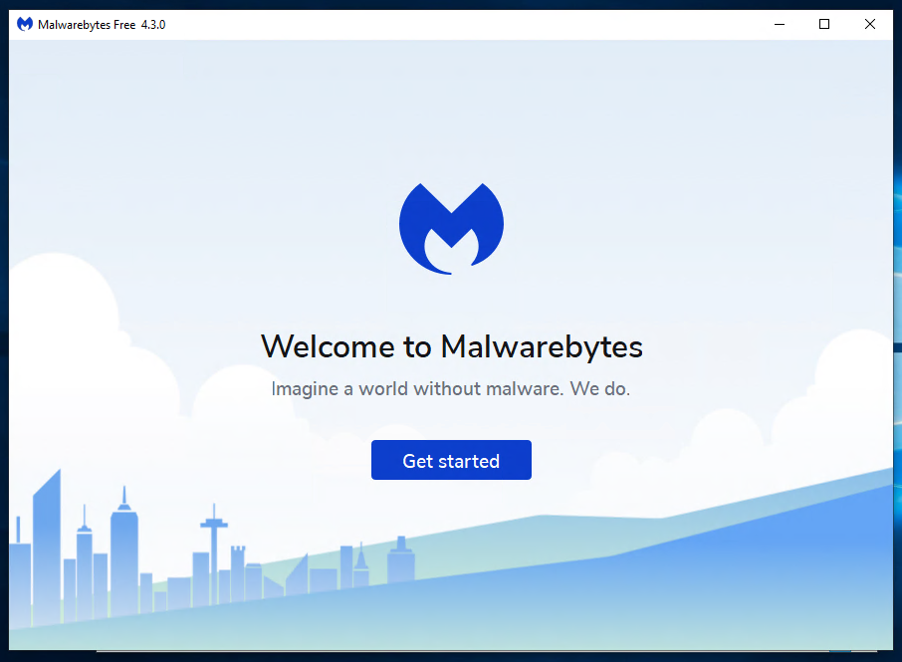
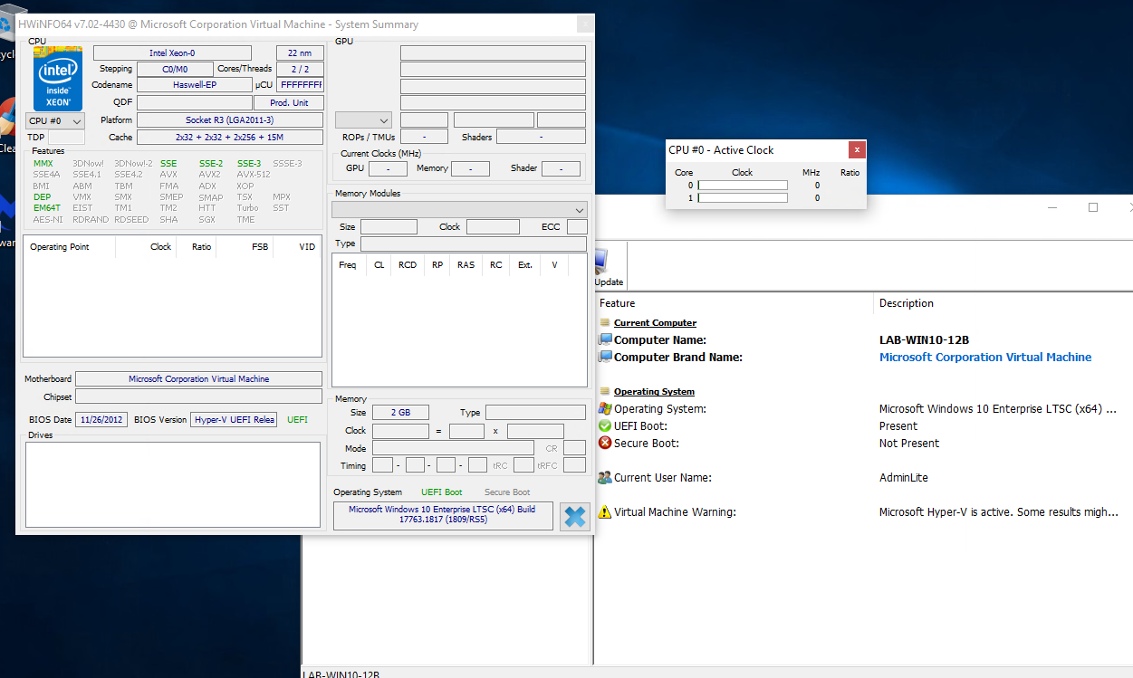
What we set out to do
Install system wide Virus/Malware protection and PC maintenance programs.
Why?
More secure
Easy for users to install these programs only if they need it. (Malwarebytes is mandatory)
Access to HWINFO is useful for troubleshooting VM’s and other workstations.
Notes:
Alex

Slide 3
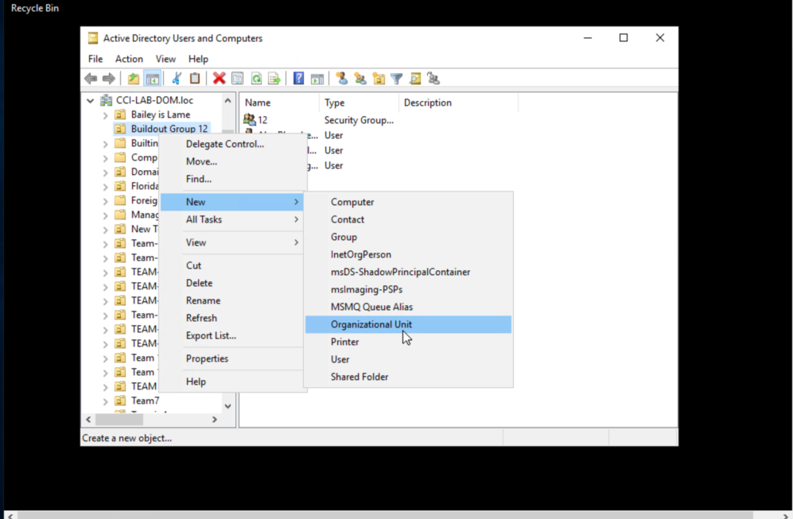
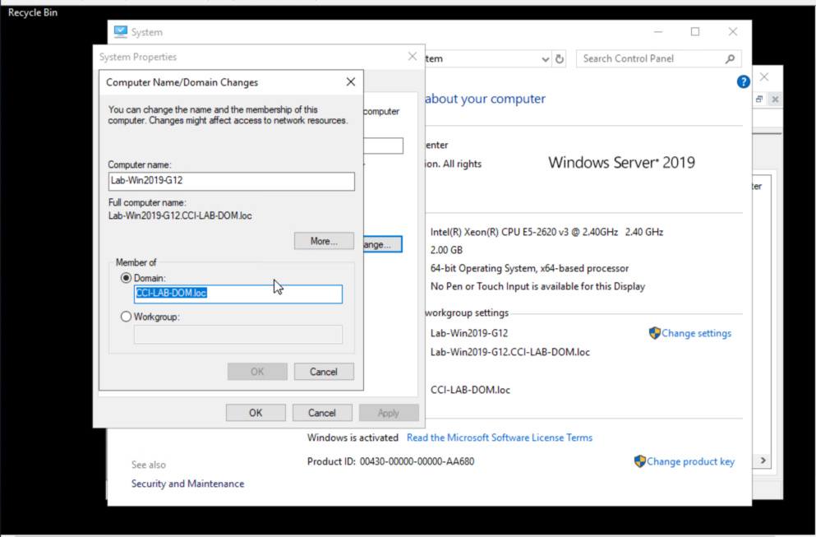
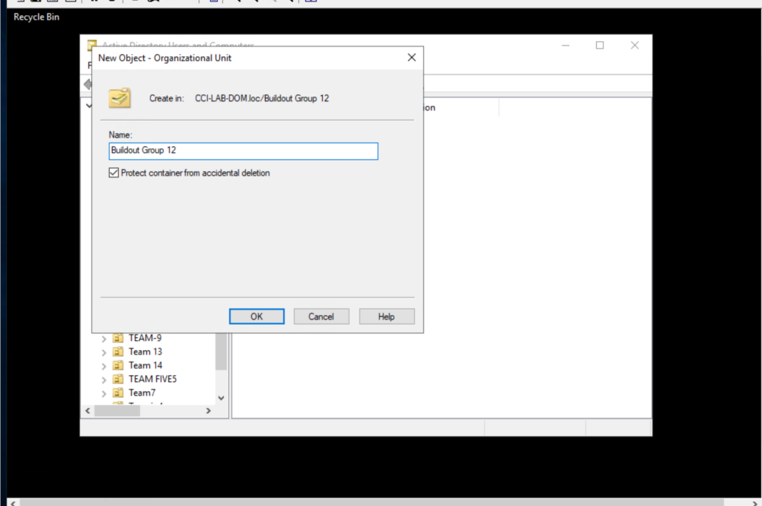
Set up an Organizational Unit

Slide 4
Network share
A network share is needed for a couple of reasons:
Users need to access the data
IT personnel can ensure that all users install the same programs on the PC’s

Slide 5
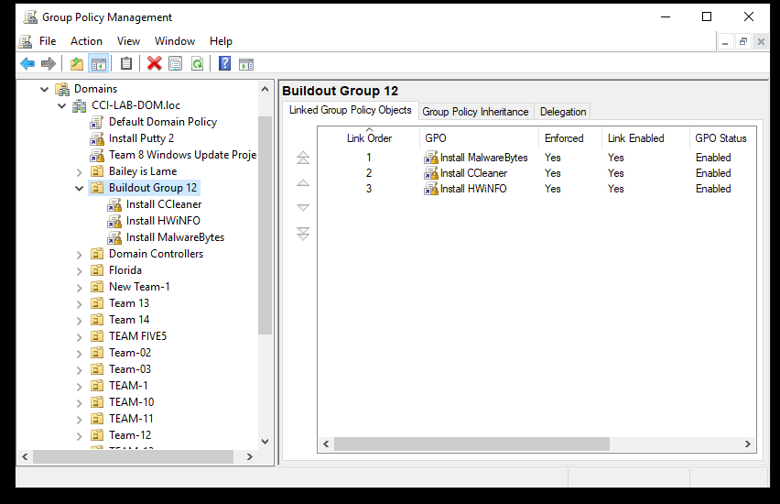
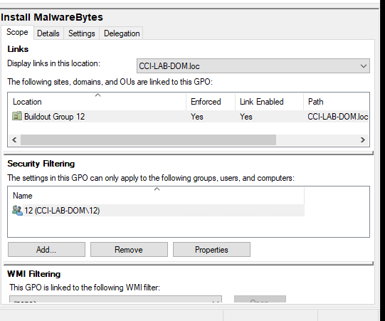
Set up Group Policy Object

Slide 6
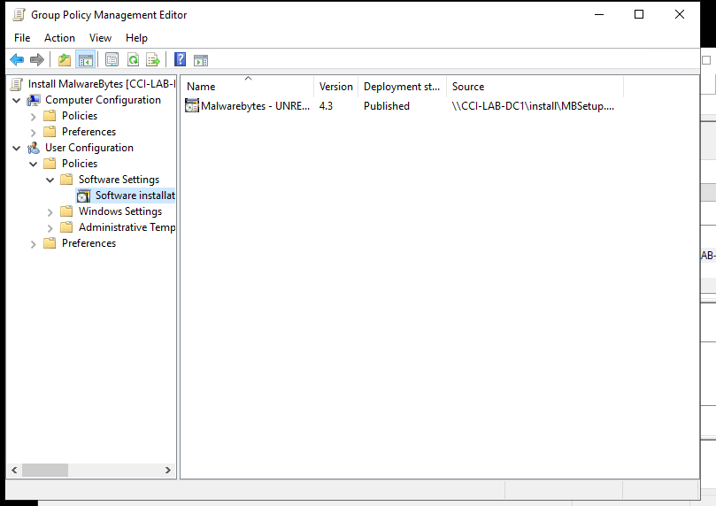
Set up GPO (Cont.)

Slide 7
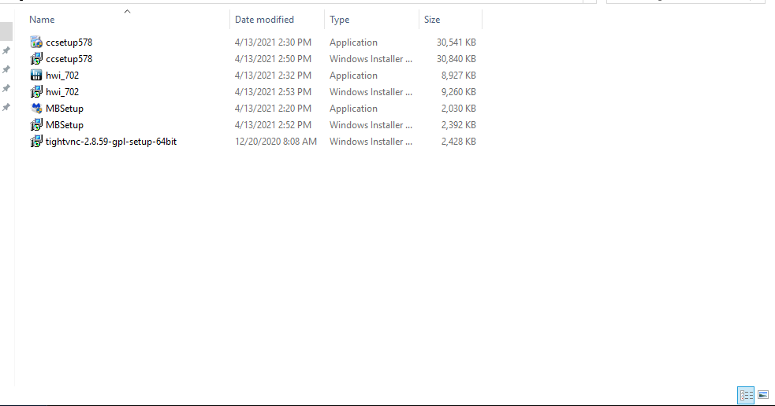
Users of the group can now install the software.
By using a network share users can easily access and install the programs needed without the need to access the web.

